Slide 1







AI-Based Solar Power Forecasting
-TEAM-03-
Team members JIVITES D- CB.SC.U4AIE24020 RAMKUMAR K R - CB.SC.U4AIE24042 MEHAN- CB.SC.U4AIE24031 SUKANTHAN- CB.SC.U4AIE24056

Slide 2
OBJECTIVES
1. Purpose of the System:
"To forecast solar power generation using AI techniques to improve prediction accuracy and energy planning."
2. Algorithm/Model Selection:
"Implement and evaluate Random Forest, XGBoost, and LSTM for solar energy prediction."
3. Data Utilization:
"Analyze historical solar power data, solar irradiance, temperature, and environmental sensor data."
4. Comparative Analysis:
"Compare ensemble models and deep learning approaches for accuracy and reliability.“
5. Practical Utility:
"Enhance energy management in smart grids by providing reliable solar power forecasts.“
6. Performance Metrics:
"Evaluate model performance using MSE, MAE, and R² score."

Slide 3
INTRODUCTION
Balancing the amount of energy generated and consumed is essential for keeping smart grids efficient and cost-effective. The production solar energy depends on its variability and climatic condition. This makes accurate forecasting very important. We are using advanced tools like machine learning and deep learning to improve solar energy predictions, helping smart grids operate more effectively.

Slide 4
About PV solar power plant
Photo Voltaic Solar Power has emerged as the best source of green energy in recent past in a country like India which gets a good amount of solar insolation. With the continuous development of efficient PV modules, Battery storage and Smart Grid etc. Power Generation through PV Solar Plant has gained the momentum further and has a very promising future.
The solar power plant is also known as the Photovoltaic (PV) power plant. It is a large-scale PV plant designed to produce bulk electrical power from solar radiation. The solar power plant uses solar energy to produce electrical power. Therefore, it is a conventional power plant.Solar energy can be used directly to produce electrical energy using solar PV panels.Hence, to produce electrical power on a large scale, solar PV panels are used. Below is the layout plan of photovoltaic power plant.

Slide 5
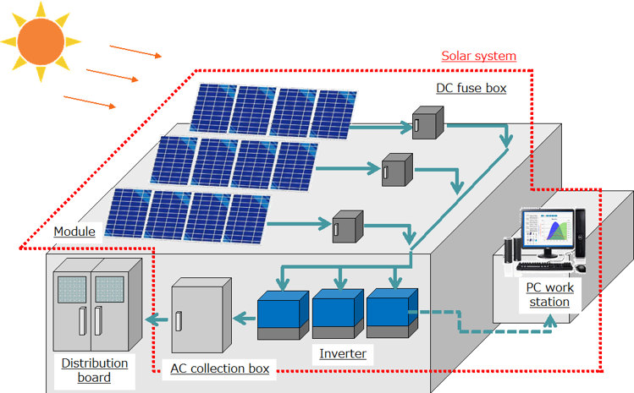
The above picture shows a typical structure of a solar power plant. Sunlight falls on PV modules, generates DC Power which is fed to the Inverters (through some Junction Box and String Monitoring Box), Inverters convert DC Power to AC Power, AC Power is stepped up through Transformers to match Grid Voltage and finally fed to the Grid through some Switchgear.

Slide 6
PROBLEM GETTING SOLVED
Better Planning: Power companies can plan ahead for times when solar energy is low by using backup energy sources or storage.
Lower Costs: Predicting solar power output can reduce costs by cutting down on unnecessary backups or storage.
Less Wastage: By predicting how much solar power will be generated, we can make sure it’s fully used and not wasted.
stable Electricity Supply: It helps manage changes in solar power, keeping the electricity grid stable
Support for Clean Energy Expansion: By making solar energy more reliable and efficient, forecasting encourages the growth of renewable energy projects, replacing traditional polluting energy sources over time

Slide 7

LITERATURE REVIEW
TITLE | DATE OF PUBLICATION | DATASET USED | MODEL AND METRICS | CHALLENGES and Contribution
Machine Learning Based Solar Photovoltaic Power Forecasting: A Review and Comparison | 24 April 2023 | Solar PV power production dataset:Residential roof top pv production Meteorological dataset information:European canter for medium range weather forecast | Metrics: Mean Absolute Error (MAE) Root Mean Squared Error (RMSE) R-Squared (R² Score) MODEL: Support Vector Machines (SVM) Random forest Deep learning(ANN) | Challenges from the intermittent nature of solar energy due to weather variability, requiring high-quality, large datasets for accurate predictions. Also, this paper focused more on summarizing other research and did not include a real case study or hands-on results Contribution: The paper performs simulations of different ML methods and compares their forecasting accuracy and computational efficiency.
Machine Learning based Solar PV Power Prediction | 22 September 2023 | The paper utilizes a solar photovoltaic (PV) power dataset collected from kaggle | Metrics: Root Mean Squared Error (RMSE) Mean Absolute Error (MAE) Model: Random forest K-nearest neighbour | .The dataset used in the papersmall, the model might not work well for bigger solar plants or longer time periods. Contribution-This paper provides significant contributions to the field of solar photovoltaic (PV) power forecasting by leveraging machine learning (ML) techniques.
Application of Machine Learning Algorithms for Solar Power Forecasting in Sri Lanka | 22 November 2018 | data set is obtained from the Buruthakanda solar farm, Hambantota, Sri Lanka with the support of the Sustainable Energy Authority | Metrics Root Mean Squared Error (RMSE) Mean Absolute Error (MAE) Model: Random forest xg boost svm | These approaches failed to handle complex weather patterns and high-dimensional data effectively. Contribution: The findings contribute to more reliable and accurate solar energy prediction models for renewable energy integration.

Slide 8
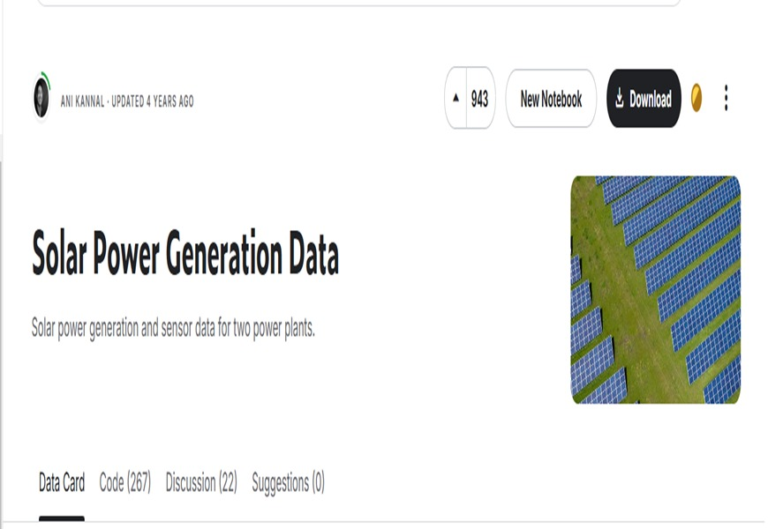
OVERVIEW OF DATASET
We will be analyzing the data of the production of solar energy from 2 solar plants in india over 34 days . It has two pairs of files - each pair has one power generation dataset and one sensor readings dataset. The power generation datasets are gathered at the inverter level - each inverter has multiple lines of solar panels attached to it. The sensor data is gathered at a plant level - single array of sensors optimally placed at the plant. Unlike other studies that use complex models or limited data, our approach is simple,practical, and uses open data.

Slide 9
FEATURES IN POWER GENERATION DATASET IN PLANT 1 AND 2
DATE_TIME: Date and time for each observation. Observations recorded at 15 minute intervals.
PLANT_ID: this will be common for the entire file.
SOURCE_KEY: Source key in this file stands for the inverter id.
DC_POWER: Amount of DC power generated by the inverter (source_key) in this 15 minute interval. Units - kW.
AC_POWER: Amount of AC power generated by the inverter (source_key) in this15 minute interval. Units – Kw
TOTAL_YIELD: This is the total yield for the inverter till that point in time.

Slide 10
FEATURES IN WEATHER SENSOR DATASET IN PLANT 1 AND 2
DATE_TIME: Date and time for each observation. Observations recorded at 15 minute intervals.
Plant ID - this will be common for the entire file.
Sensor panel id. This will be common for the entire file because there's only one sensor panel
AMBIENT_TEMPERATURE: This is the ambient temperature at the plant, refers to the temperature of the air or environment surrounding the solar panels or inverters at a specific time. .
MODULE TEMPERATURE: refers to the temperature of the surface of a solar panel (also known as a photovoltaic module) at a specific time. Mmeasured in degrees Celsius (°C)
IRRADIATION: Amount of irradiation for the 15 minute interval.

Slide 11
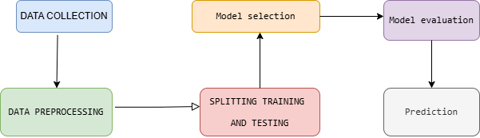
BLOCK DIAGRAM

Slide 12
METHODOLOGY
Data collection: We are using Solar Power Generation Data from Kaggle.
About Dataset:This data has been gathered at two solar power plants in India over a 34 day period. It has two pairs of files - each pair has one power generation dataset and one sensor readings dataset. The power generation datasets are gathered at the inverter level - each inverter has multiple lines of solar panels attached to it. The sensor data is gathered at a plant level - single array of sensors optimally placed at the plant
DATA PREPROCESSING:
Remove missing values: If data is missing, it can cause incorrect predictions. Techniques such as filling missing values with averages or removing them entirely can be used.Remove duplicate entries: Sometimes, due to multiple sensors or logging issues, data points may be repeated. These duplicates need to be eliminated.
Converting Date-Time Format:Convert all timestamps into a single uniform format (e.g., HH:MM:SS).Ensure that timestamps are correctly interpreted as time objects rather than simple text values.Synchronize timestamps between different datasets to ensure proper alignment of solar power data and weather data

Slide 13
Merging Power and Sensor Data:Merge datasets based on timestamps: Since both power generation data and weather data contain timestamps, they should be aligned so that the AI model knows the weather conditions at the exact time when power was generated.
Remove unnecessary columns: Some columns, like plant IDs, may not be required for training and should be removed to simplify the dataset.
Extracting Time-Based Features:Extract key time components such as year, month, day, hour, and minutes from timestamps.Calculate total minutes passed in a day, which helps represent time as a continuous numerical value. Identify patterns in power generation by linking time of day to energy output.
.Defining Input (X) and Output (Y)
Define X (independent variables) → Includes temperature, irradiance, time, and panel ID.
Define Y (dependent variable) → The AI model will predict the AC power output.Ensure that both X and Y are correctly formatted as numerical values.

Slide 14
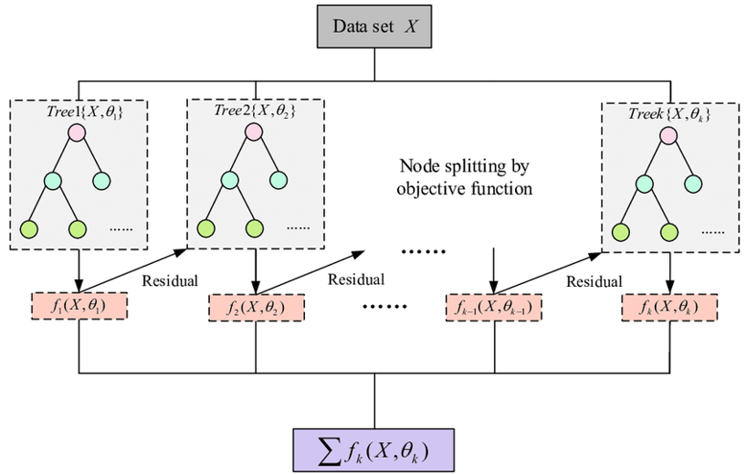
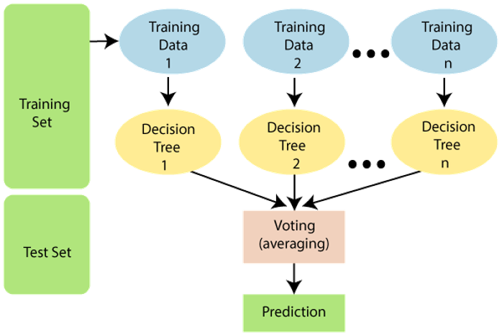
MODEL SELECTION
XG BOOST
XGBoost (Extreme Gradient Boosting) is a machine learning algorithm that is excellent for handling structured data like tables. It works by building multiple decision trees sequentially, where each new tree corrects the errors of the previous ones.XGBoost is fast, handles missing data well, and can capture complex relationships between features.It handled the structured data efficiently, especially with aggregated inverter data.
RANDOM FOREST
Random Forest is an ensemble learning algorithm that operates by constructing multiple decision trees during training and outputting the mode (classification) or mean (regression) of the predictions from individual trees. It is widely used for classification, regression, and feature selection tasks due to its robustness, accuracy, and ability to handle non-linearity and missing data.

Slide 15
MODEL SELECTION
LSTM
For solar power forecasting, various models can be considered, including statistical methods, traditional machine learning algorithms, and deep learning techniques. The choice of the LSTM (Long Short-Term Memory) model is based on its superior ability to capture temporal dependencies in time-series data.
It efficiently handles long-range dependencies in time-series data.
It learns patterns from historical solar radiation, temperature, and other weather factors. It mitigates issues like vanishing gradients, which affect standard RNNs.
Key Components of LSTM:
Forget Gate: Decides which past information to discard.
Input Gate: Determines which new information should be stored.
Cell State: Acts as the memory unit, preserving long-term dependencies.
Output Gate: Regulates the final output of the LSTM unit

Slide 16
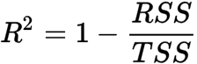
METRICS
To evaluate the effectiveness of the AI-based solar power forecasting model, the following metrics were analyzed:
R² Score (Coefficient of Determination):
Measures how well the model explains the variance in solar power generation.
A high R² score demonstrates strong alignment with real-world solar generation patterns.
R² Score ensures the model captures seasonal/daily trends in solar energy
R^2 = coefficient of determination
RSS = sum of squares of residuals
TSS = total sum of squares

Slide 17
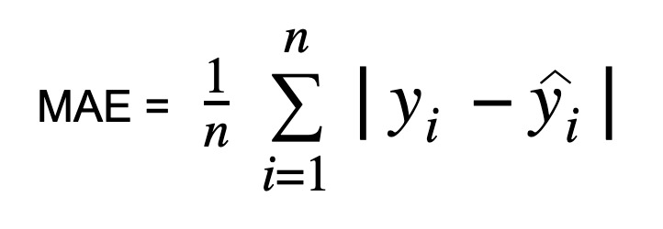
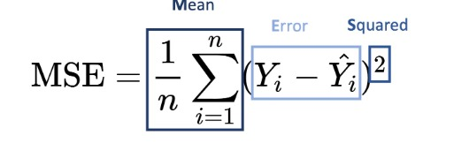
MEAN ABSOLUTE ERROR (MAE)
Represents the average absolute difference between predicted and actual solar power values.
MAE translates to actionable insights for energy stakeholders (e.g., expected daily prediction errors).
Low MAE values indicate reliable predictions
MEAN SQUARED ERROR
Penalizes larger prediction errors by squaring deviations between forecasts and actual values.
MSE identifies risks of large forecasting inaccuracies, crucial for grid stability.
Low MSE values indicate reliable predictions, critical for grid operators to balance supply-demand and optimize energy storage.

Slide 18
INPUT FROM USER
The system collects 7 dynamic parameters interactively from the user to predict AC power output. These include environmental metrics like ambient temperature, module temperature, and irradiation, as well as temporal details such as hour, and minutes. A unique SOURCE_KEY identifier is included to track the solar plant or device. The AC_POWER field is intentionally set to 0.0 during input since it is the target variable being predicted. Users provide numerical values for each parameter, which are then structured into a standardized DataFrame. The input data undergoes scaling using a pre-trained normalizer/standardizer to align it with the model’s training distribution. Finally, the data is reshaped into a time-series sequence (replicated to match the LSTM’s required input length) to simulate temporal dependencies. This streamlined process ensures real-time compatibility and accurate predictions.
A low prediction may indicate poor irradiation, shading, or sensor errors.
A high prediction could suggest optimal conditions or calibration drift.
Seasonal/time-based trends (e.g., lower winter irradiation) may affect results

Slide 19
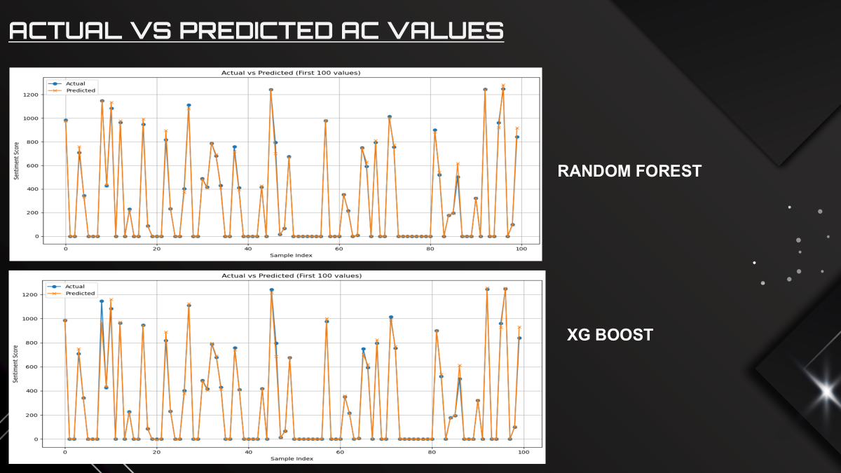
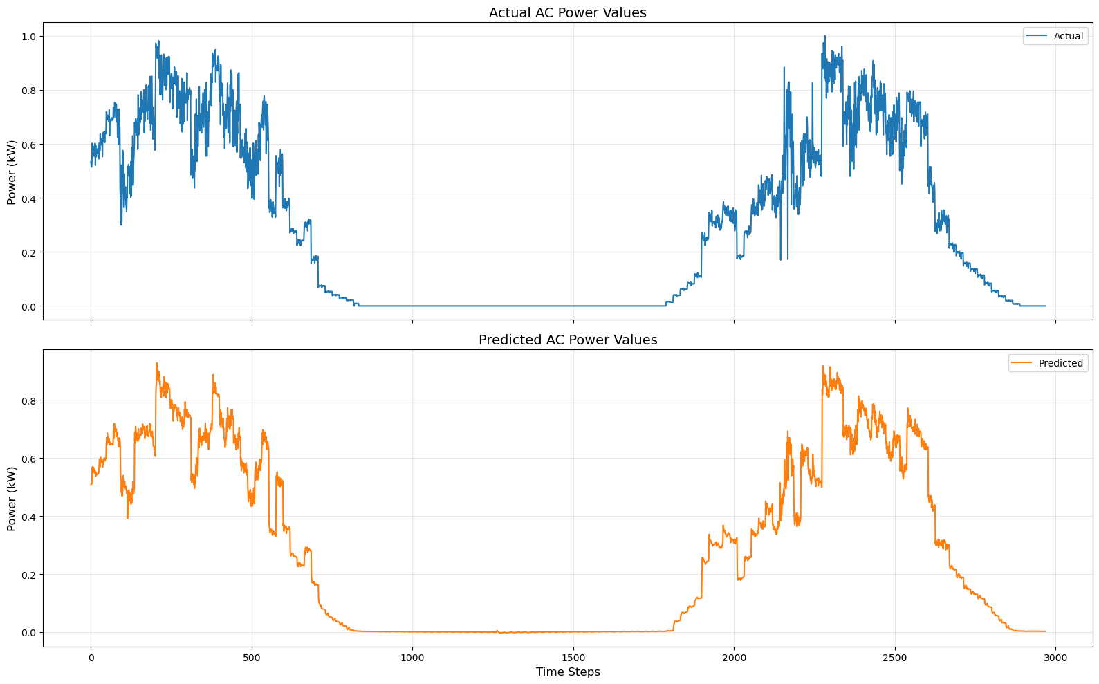
ACTUAL VS PREDICTED AC VALUES

Slide 20
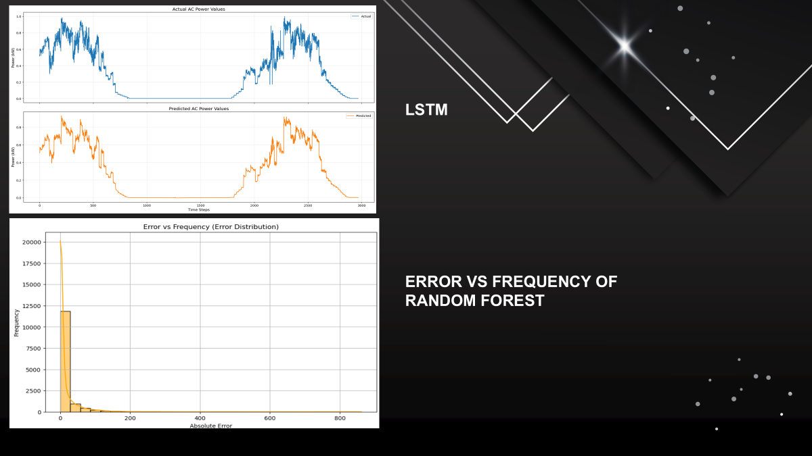
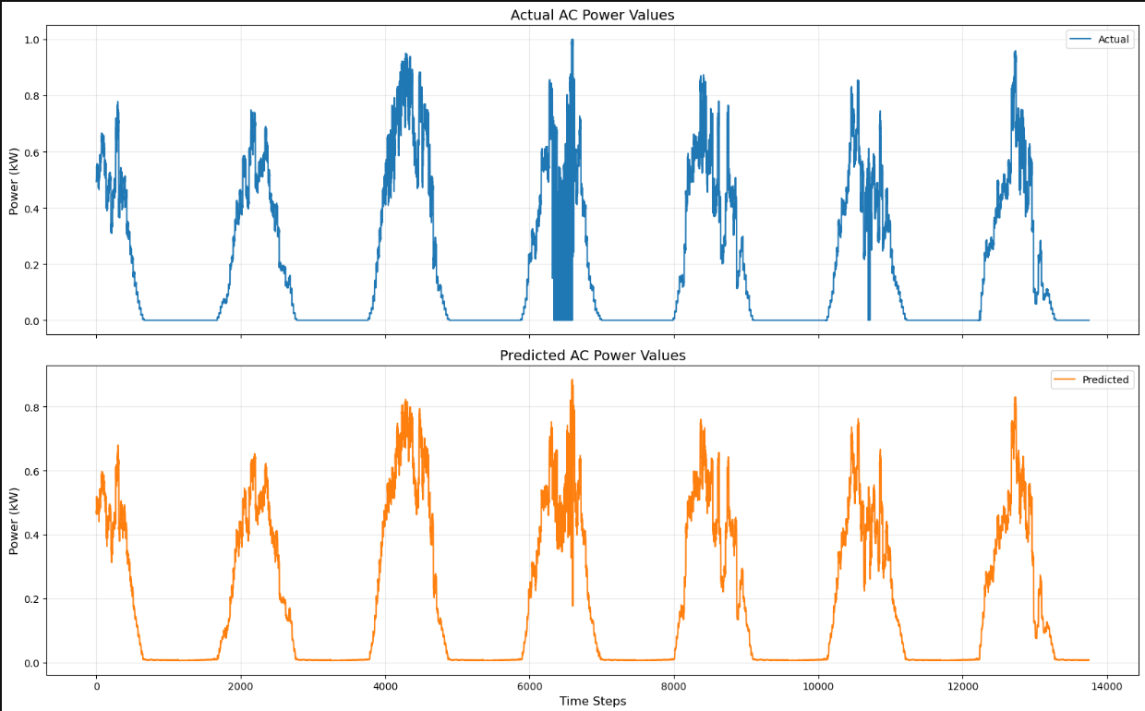

Slide 21
RESULT AND ANALYSIS
Why Random Forest for Solar Power Forecasting?
After evaluating multiple models — Random Forest, XGBoost, and LSTM . Random Forest was selected as the final model due to its strong balance between accuracy, consistency, and robustness:
High Accuracy: Achieved an impressive R² score of 98.7%, closely matching XGBoost (99%) while outperforming LSTM (97%).
Stable & Consistent: Unlike XGBoost, which showed higher fluctuations and poor handling of certain peak values, Random Forest delivered more reliable predictions across different time periods and it was consistent.
Robust to Overfitting: Random Forest’s ensemble nature helps in reducing overfitting, making it more generalizable compared to XGBoost which can sometimes overfit noisy peak points.
Less Complexity: Random Forest requires minimal data preprocessing (like scaling) and is easier to tune compared to LSTM, which needs careful handling of time series sequences.
Faster Training: It also trains faster than deep learning models like LSTM, making it more suitable for real-time or rapid development cycles

Slide 22

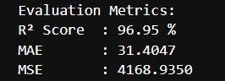
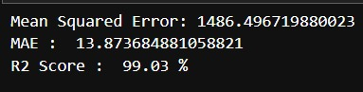
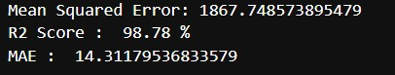
LSTM
RANDOM FOREST
XG BOOST

Slide 23
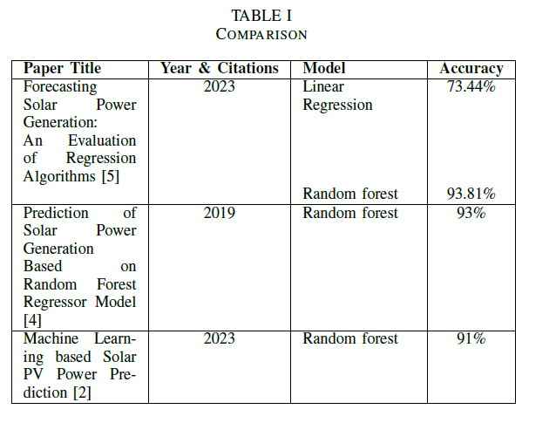

Slide 24
IMPLEMENTATION
UI design for a solar power forecasting application. The design ensures that it is user-friendly, visually appealing
OUTPUT
PREDICTED AC POWER
ALERTS AND RECOMMENDATION
SUGGESTIONS
INPUT FROM USER
AMBIENT TEMPERATURE
MODULE TEMPERATURE
IRRADIATION
TIME

Slide 25
Alerts and Recommendations
High Solar Output: Excellent energy generation.
1.Maximize energy storage (if battery system available)
2. Schedule high-energy tasks like EV charging.
3.Store excess energy or sell it to the grid.
4.Monitor panel performance for consistency.

Slide 26
Moderate Solar Output: Good generation with balanced efficiency,Run essential appliances as needed.Conserve energy where possible. Consider partially charging backup batteries.
Low Solar Output: Limited energy available.Use only essential appliances. Check for shading or dirt on panels.Evaluate panel orientation. Consider system expansion.
Very Low Solar Output: Insufficient for peak energy needs.Switch to backup sources. Reduce non-essential usage. Power only critical systems. Delay energy-heavy tasks.Schedule high-use operations for peak sunlight.

Slide 27
CONCLUSION
Ai-based Solar- Power Forecasting is done by leveraging solar generation data along with associated temperature data for time series analysis .This leads as to e advancement of solar power forecasting methods, which are necessary for the effective grid integration of solar energy.
In this project we have used 3 machine learning approaches, namely Random Forest ,XGBoost and deep learning LSTM models, for making day-ahead forecasts of solar power generation.In order to assess how well the model performs in predicting solar power production over longer time horizons, the project can be extended to predict horizon to include longer time frames

Slide 28
THANK YOU!!

